Slide 1


Azərbaycan Dövlət Neft və Sənaye Universiteti
Calculus
Single Variable

Slide 2
Infinite Limits

Slide 3
Outline
Determine infinite limits from the left and from the right.
Find and sketch the vertical asymptotes of the graph of a function.

Slide 4
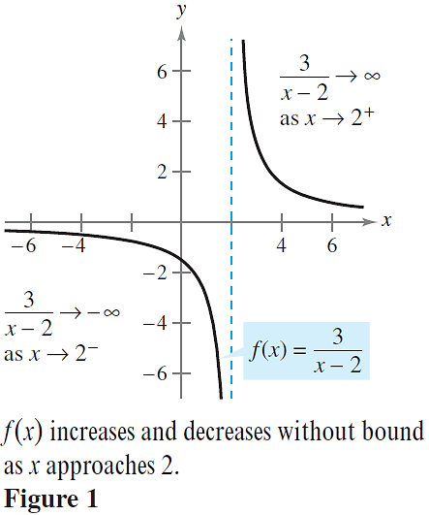
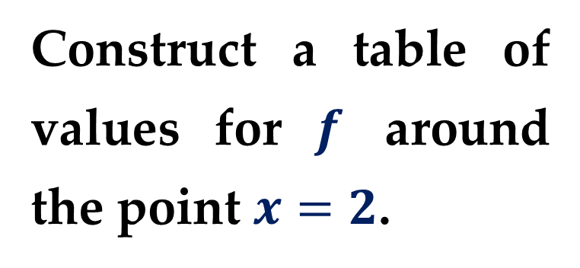
Let $f$ be the function given by $\frac{3}{x−2}$ (see $Figure 1$).
Construct a table of values for $f$ around the point $x=2$.

Slide 5
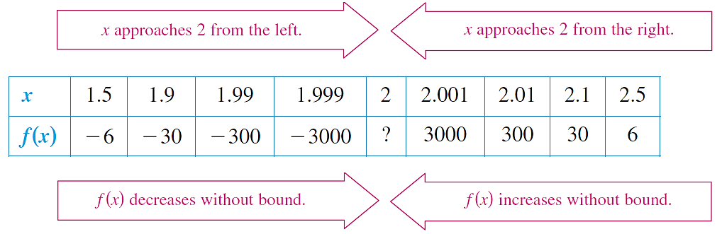
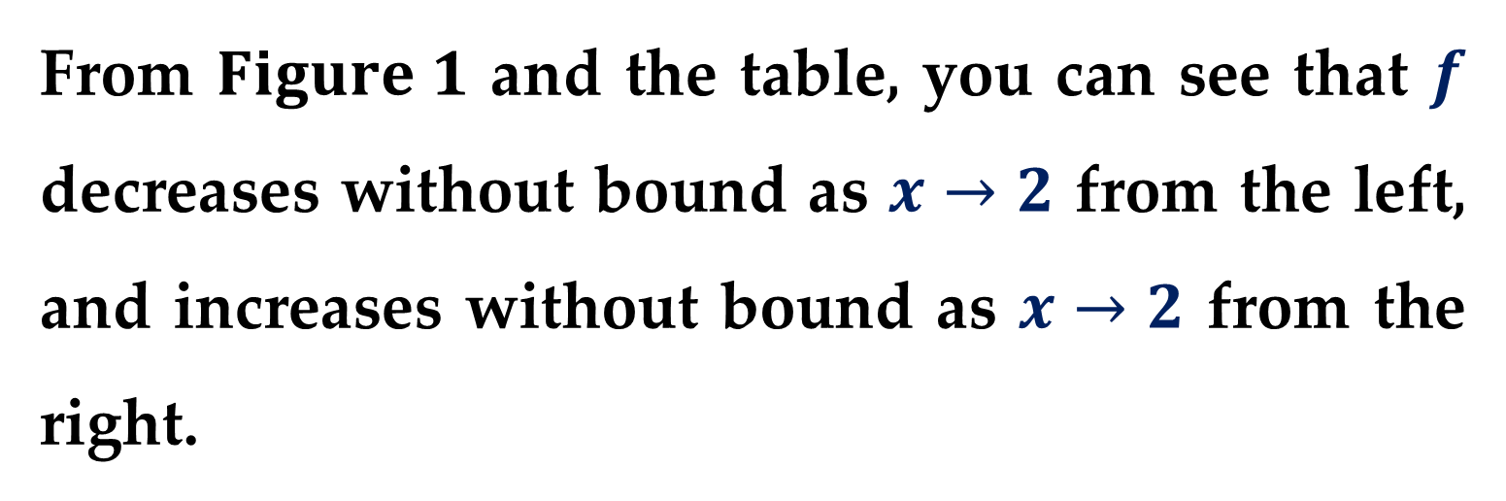
From $Figure 1$ and the table, you can see that $f$ decreases without bound as $x→2$ from the left, and increases without bound as $x→2$ from the right.

Slide 6
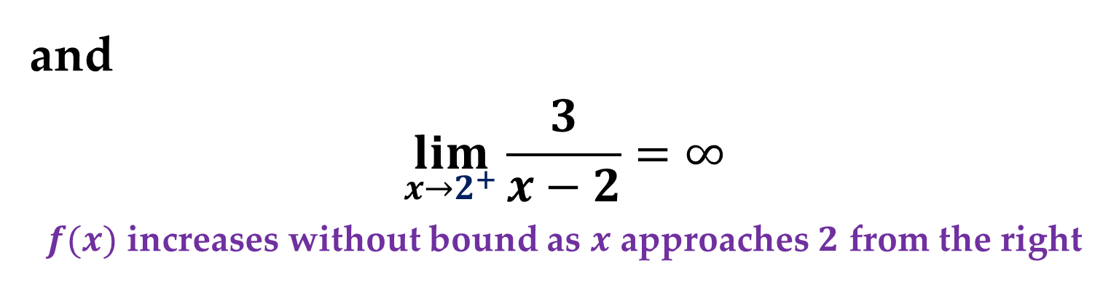
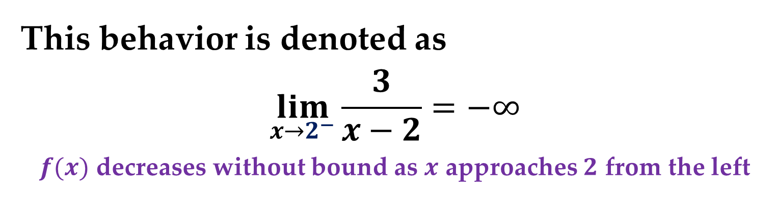
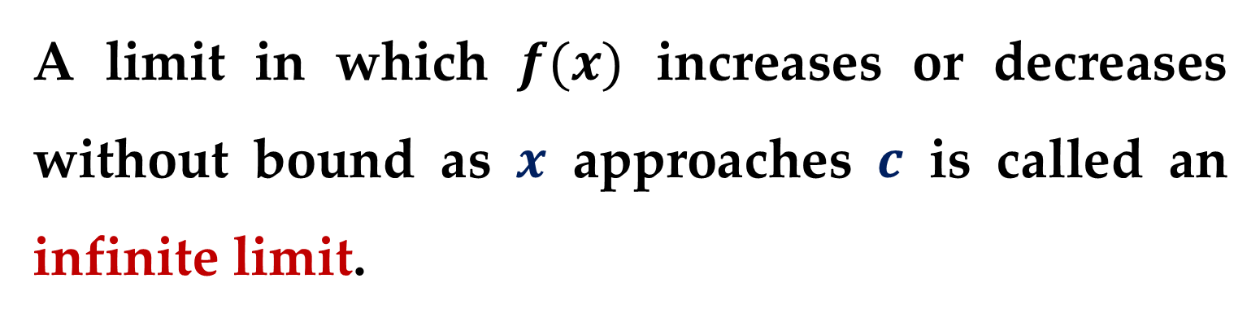
This behavior is denoted as
$$\lim_{x→2^{−}}{\frac{3}{x−2}}=−∞$$
$f(x)$ decreases without bound as $x$ approaches $2$ from the left
and
$$\lim_{x→2^{+}}{\frac{3}{x−2}}=∞$$
$f(x)$ increases without bound as $x$ approaches $2$ from the right
A limit in which $f(x)$ increases or decreases without bound as $x$ approaches $c$ is called an infinite limit.

Slide 7
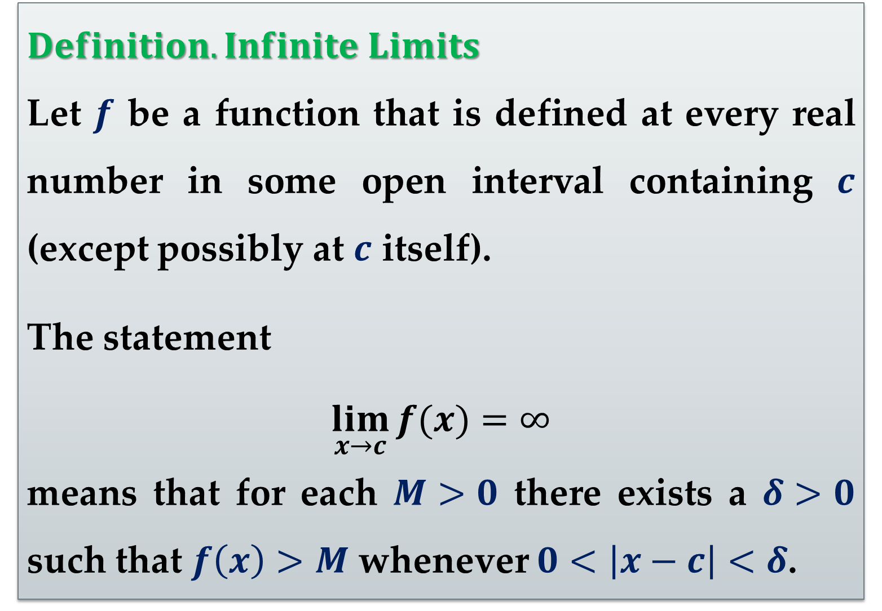
$Definition. Infinite Limits$
Let $f$ be a function that is defined at every real number in some open interval containing $c$ (except possibly at $c$ itself).
The statement
$$\lim_{x→c}{f(x)}=∞$$
means that for each $M>0$ there exists a $δ>0$ such that $f\left(x\right)>M$ whenever $0<\left|x−c\right|<δ$.

Slide 8
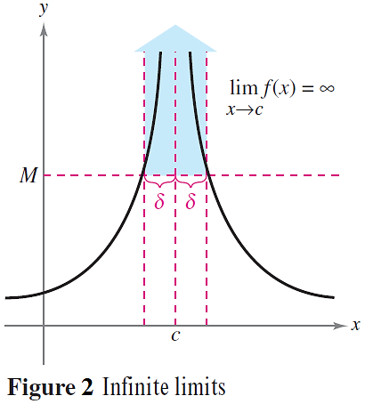
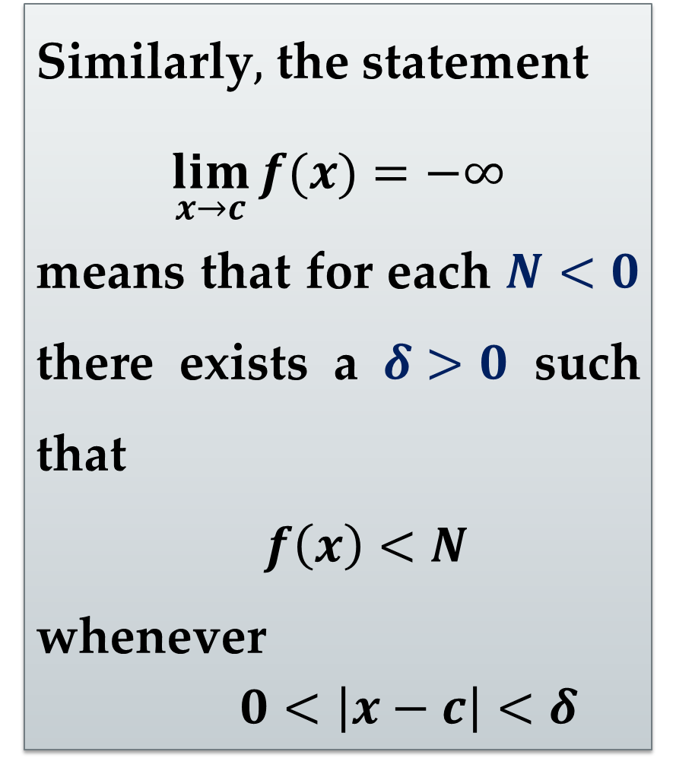
Similarly$,$ the statement
$$\lim_{x→c}{f(x)}=−∞$$
means that for each $N<0$ there exists a $δ>0$ such that
$f\left(x\right)<N$
whenever
$0<\left|x−c\right|<δ$

Slide 9
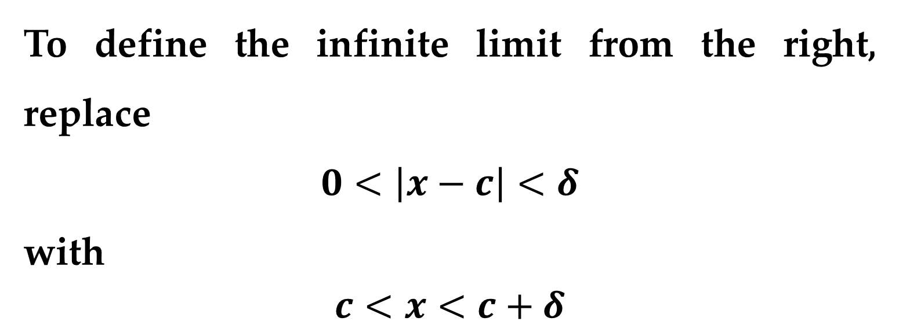
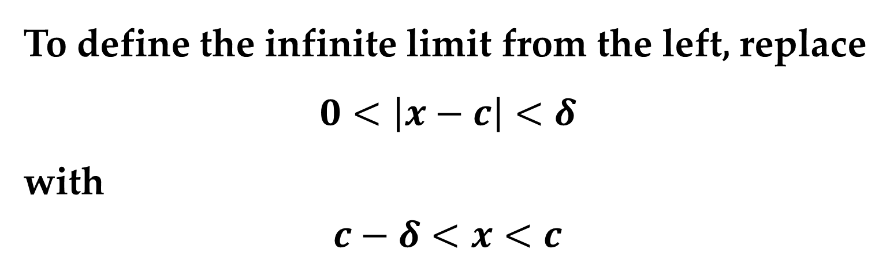
To define the infinite limit from the left, replace
$$0<\left|x−c\right|<δ$$
with
$c−δ<x<c$
To define the infinite limit from the right, replace
$$0<\left|x−c\right|<δ$$
with
$$c<x<c+δ$$

Slide 10
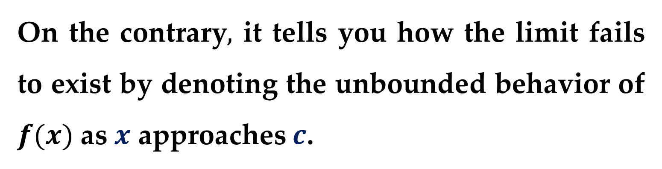
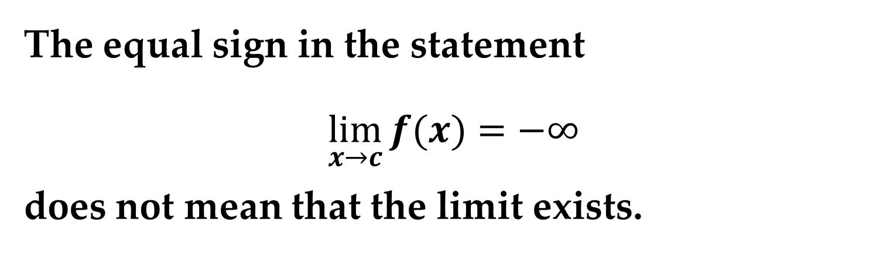
Remark
The equal sign in the statement
$$\lim_{x→c}{f(x)}=−∞$$
does not mean that the limit exists.
On the contrary$,$ it tells you how the limit fails to exist by denoting the unbounded behavior of $f(x)$ as $x$ approaches $c$.

Slide 11
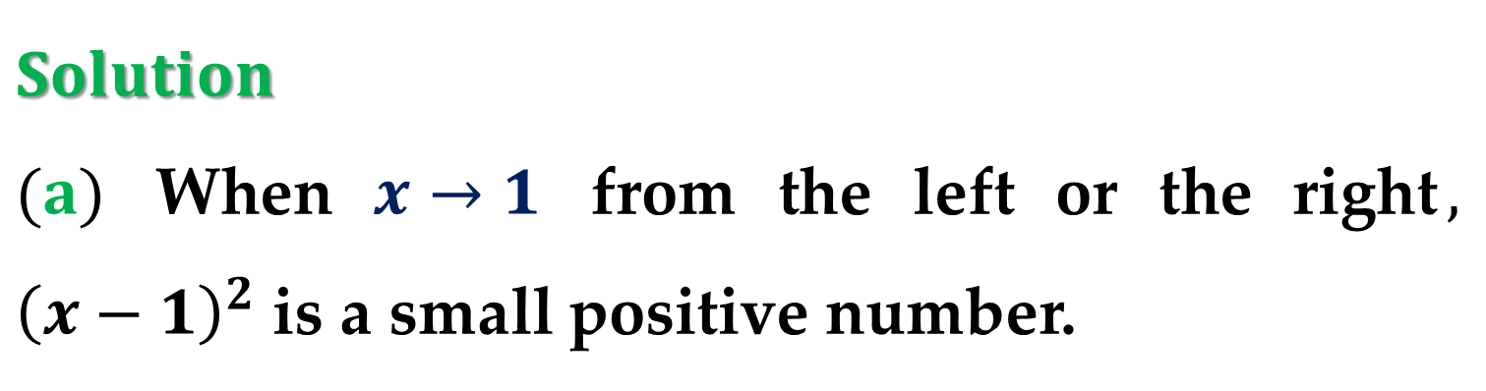
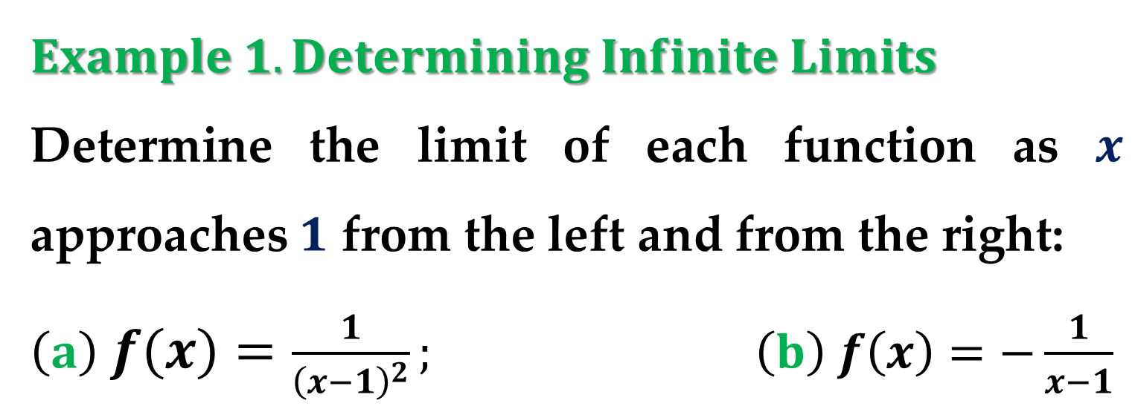
$Example 1. Determining Infinite Limits$
Determine the limit of each function as $x$ approaches $1$ from the left and from the right:
$\left(a\right) f\left(x\right)=\frac{1}{{\left(x−1\right)}^{2}}; \left(b\right) f\left(x\right)=−\frac{1}{x−1}$
$Solution$
$(a)$ When $x→1$ from the left or the right$,$ ${\left(x−1\right)}^{2}$ is a small positive number.

Slide 12
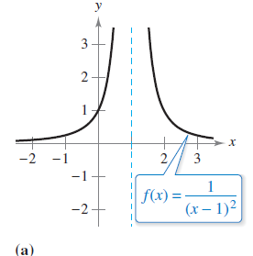
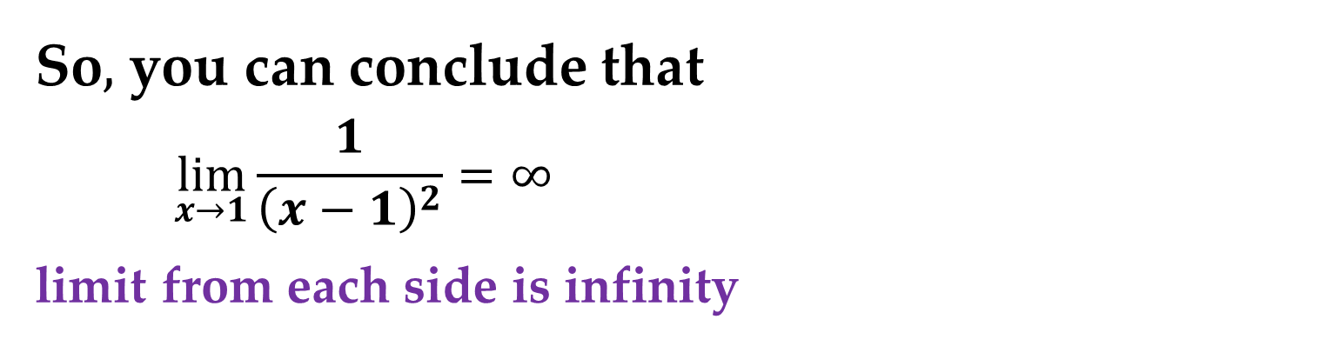
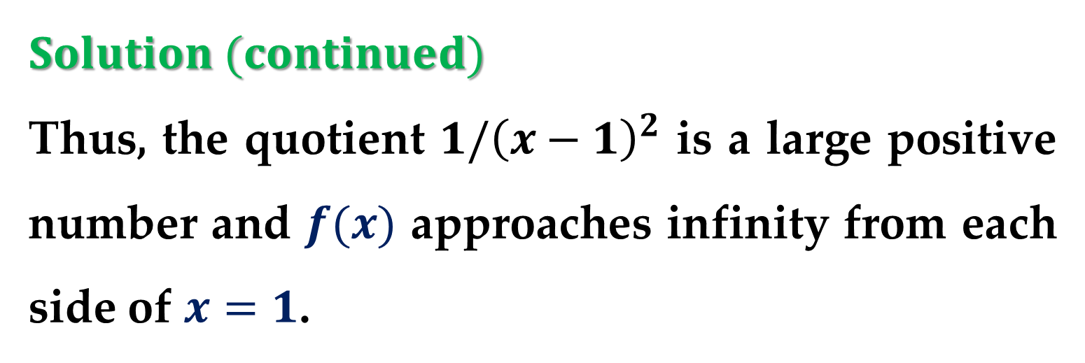
$Solution (continued)$
Thus, the quotient $1/{\left(x−1\right)}^{2}$ is a large positive number and $f(x)$ approaches infinity from each side of $x=1$.
So$,$ you can conclude that
$$\lim_{x→1}{\frac{1}{{\left(x−1\right)}^{2}}}=∞$$
limit from each side is infinity

Slide 13
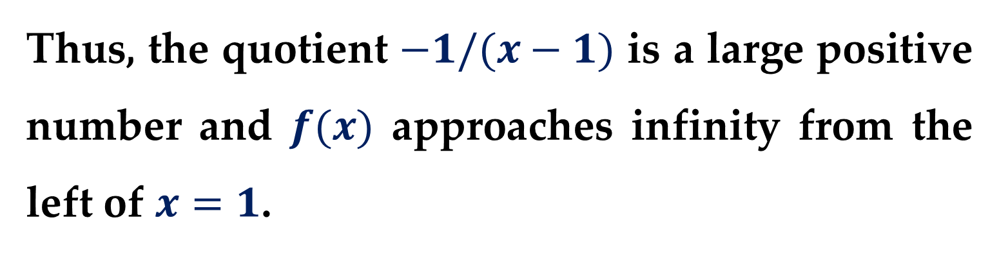
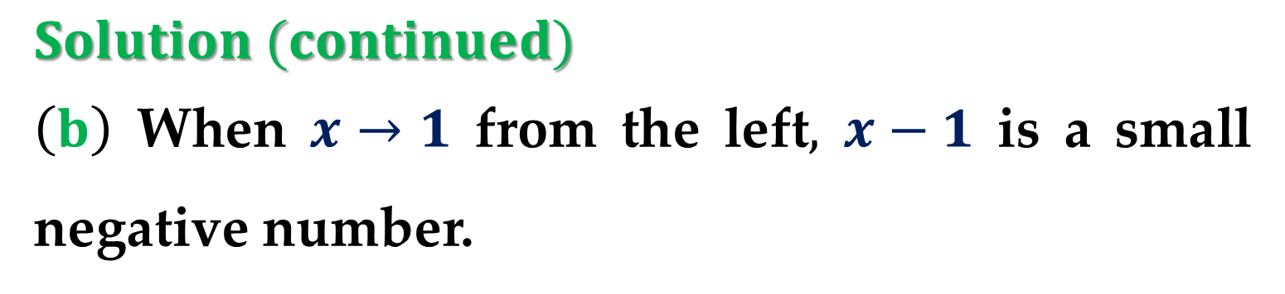

$Solution (continued)$
$\left(b\right)$ When $x→1$ from the left$,$ $x−1$ is a small negative number.
Thus, the quotient $−1/(x−1)$ is a large positive number and $f(x)$ approaches infinity from the left of $x=1$.
So$,$ you can conclude that
$$\lim_{x→1^{−}}{\frac{−1}{x−1}}=∞$$
limit from the left side is infinity

Slide 14
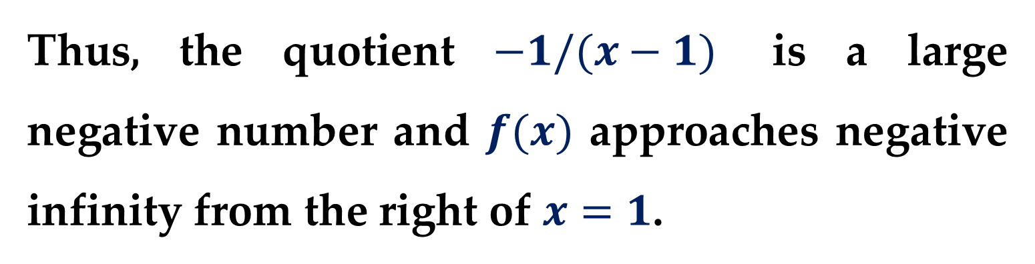
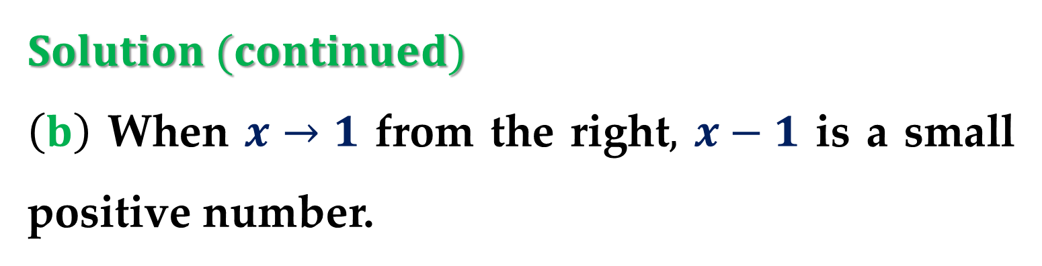
$Solution (continued)$
$\left(b\right)$ When $x→1$ from the right$,$ $x−1$ is a small positive number.
Thus, the quotient $−1/(x−1)$ is a large negative number and $f(x)$ approaches negative infinity from the right of $x=1$.

Slide 15
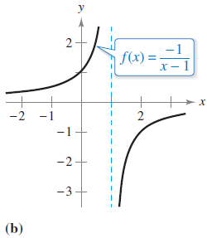
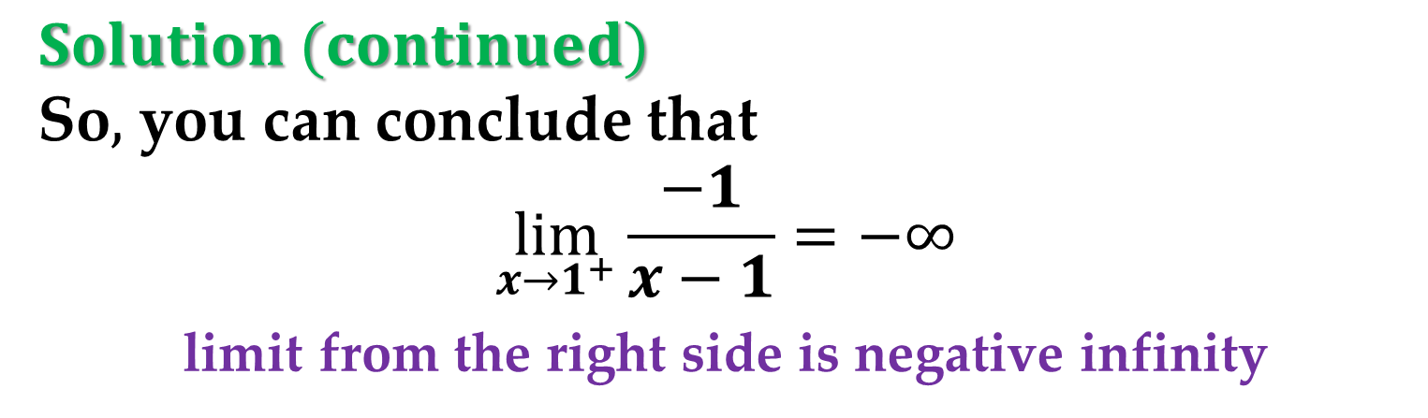
$Solution (continued)$
So$,$ you can conclude that
$$\lim_{x→1^{+}}{\frac{−1}{x−1}}=−∞$$
limit from the right side is negative infinity

Slide 16
Vertical Asymptotes

Slide 17
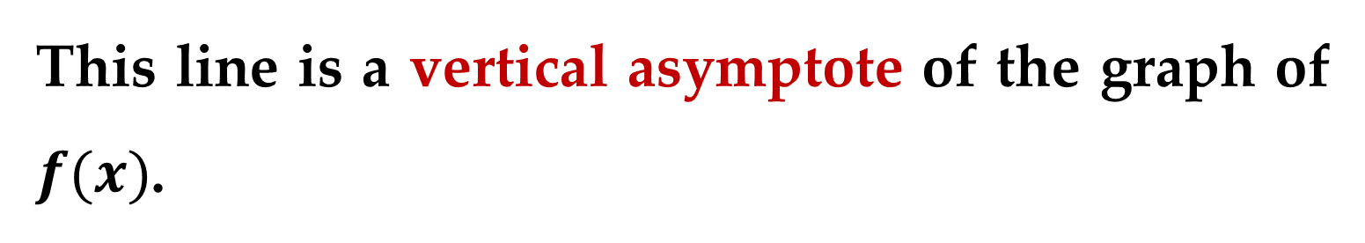
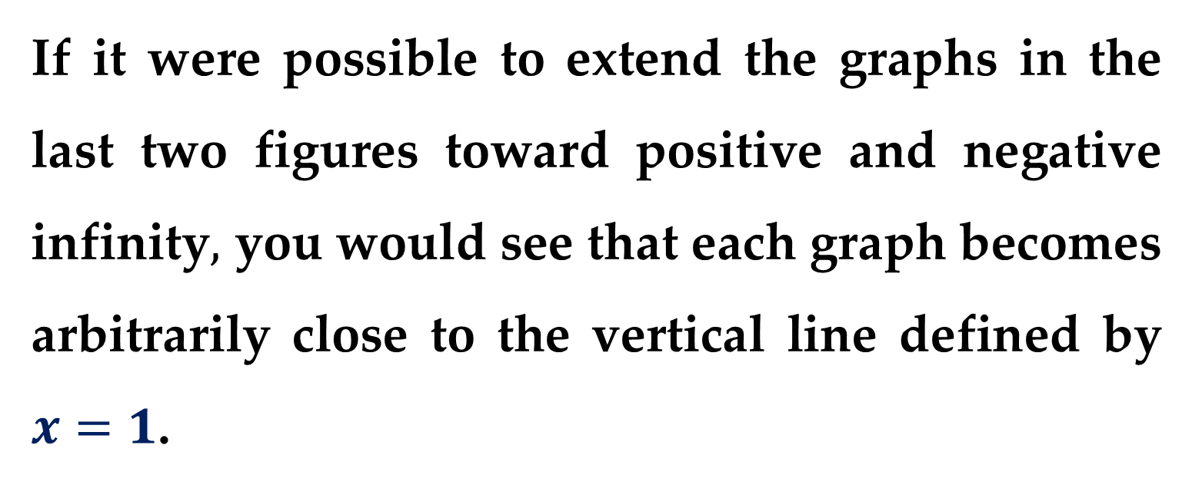
If it were possible to extend the graphs in the last two figures toward positive and negative infinity$,$ you would see that each graph becomes arbitrarily close to the vertical line defined by $x=1$.
This line is a vertical asymptote of the graph of $f(x)$.

Slide 18
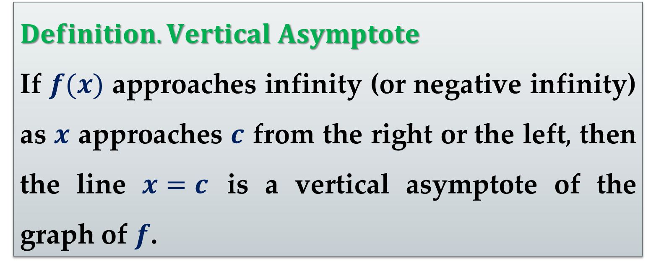
$Definition. Vertical Asymptote$
If $f(x)$ approaches infinity (or negative infinity) as $x$ approaches $c$ from the right or the left$,$ then the line $x=c$ is a vertical asymptote of the graph of $f$.

Slide 19
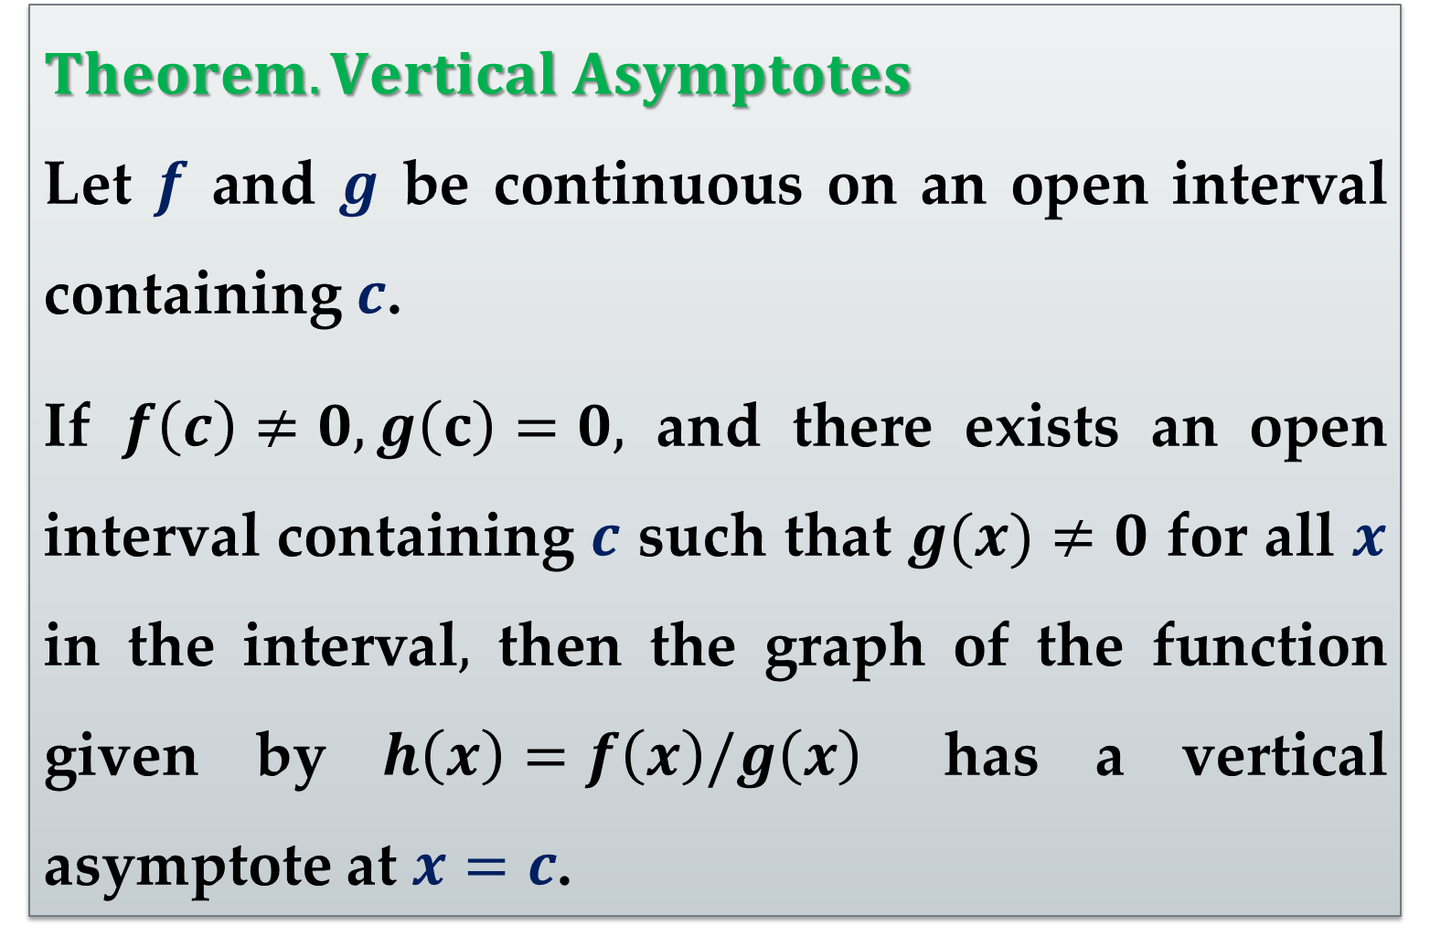
$Theorem. Vertical Asymptotes$
Let $f$ and $g$ be continuous on an open interval containing $c$.
If $f\left(c\right)≠0, g\left(c\right)=0,$ and there exists an open interval containing $c$ such that $g(x)≠0$ for all $x$ in the interval$,$ then the graph of the function given by $h\left(x\right)=f\left(x\right)/g\left(x\right)$ has a vertical asymptote at $x=c$.

Slide 20
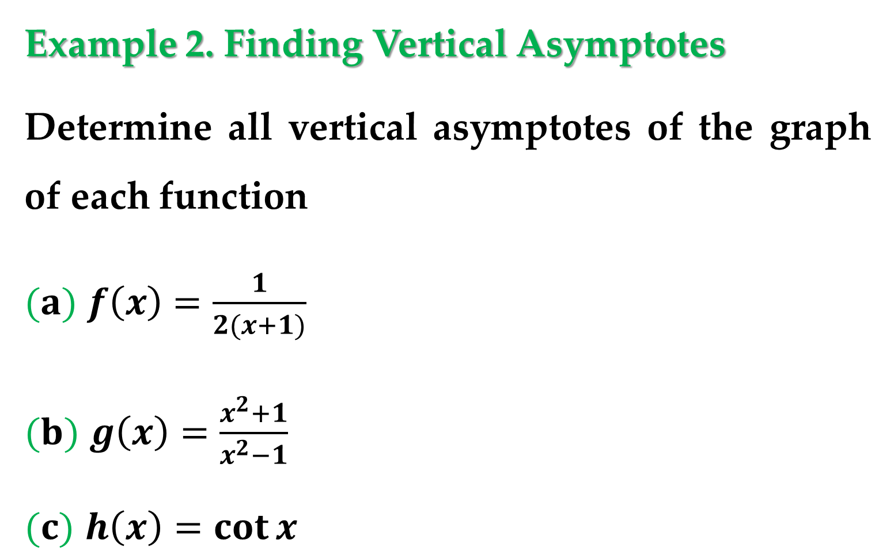
Example 2. Finding Vertical Asymptotes
Determine all vertical asymptotes of the graph of each function
$(a)$ $f\left(x\right)=\frac{1}{2(x+1)}$
$(b)$ $g\left(x\right)=\frac{x^{2}+1}{x^{2}−1}$
$(c)$ $h\left(x\right)=\cot{x}$

Slide 21
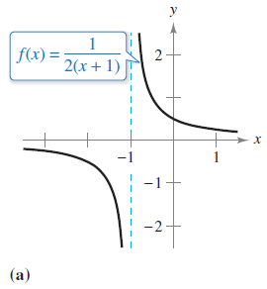
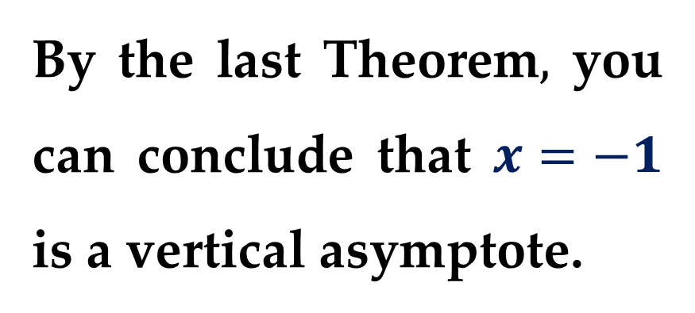
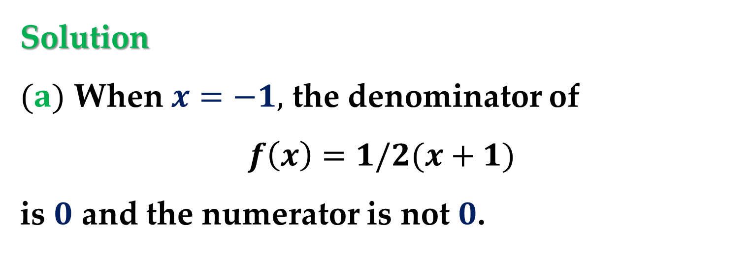
$\text{Solution}$
$(a)$ When $x=−1,$ the denominator of
$$f\left(x\right)=1/2(x+1)$$
is $0$ and the numerator is not $0$.
By the last Theorem$,$ you can conclude that $x=−1$ is a vertical asymptote.

Slide 22
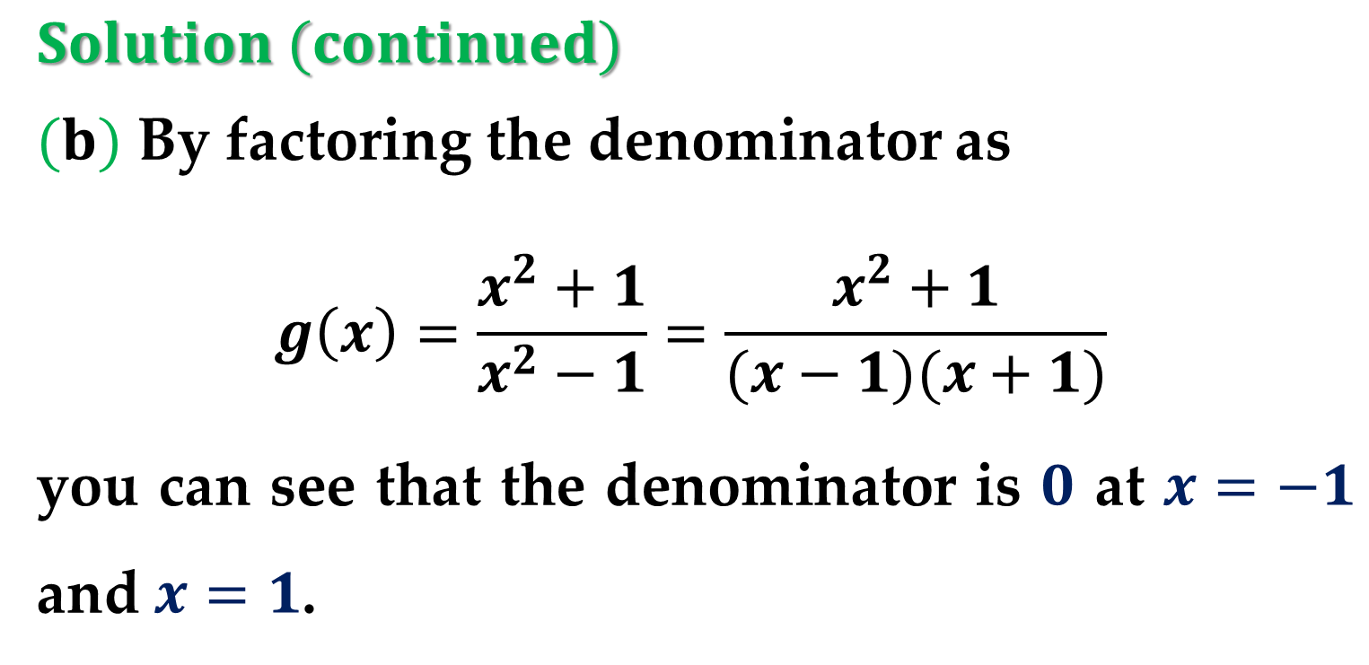
$Solution (continued)$
$(b)$ By factoring the denominator as
$$g\left(x\right)=\frac{x^{2}+1}{x^{2}−1}=\frac{x^{2}+1}{(x−1)(x+1)}$$
you can see that the denominator is $0$ at $x=−1$ and $x=1$.

Slide 23
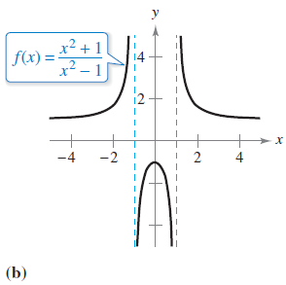
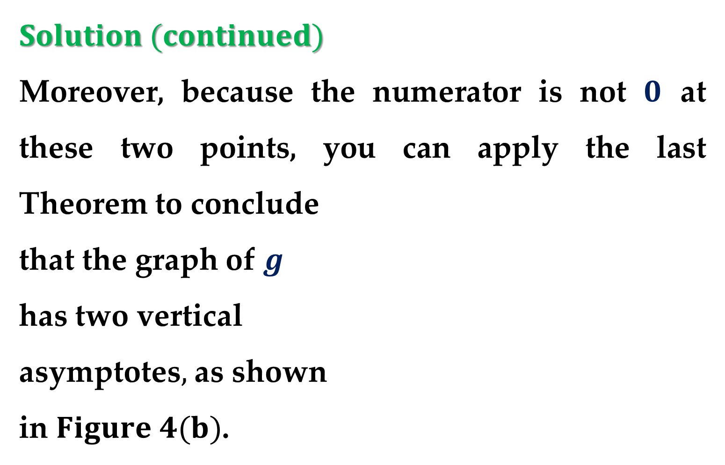
$Solution (continued)$
Moreover, because the numerator is not $0$ at these two points, you can apply the last Theorem to conclude
that the graph of $g$
has two vertical
asymptotes$,$ as shown
in $Figure 4(b)$.

Slide 24
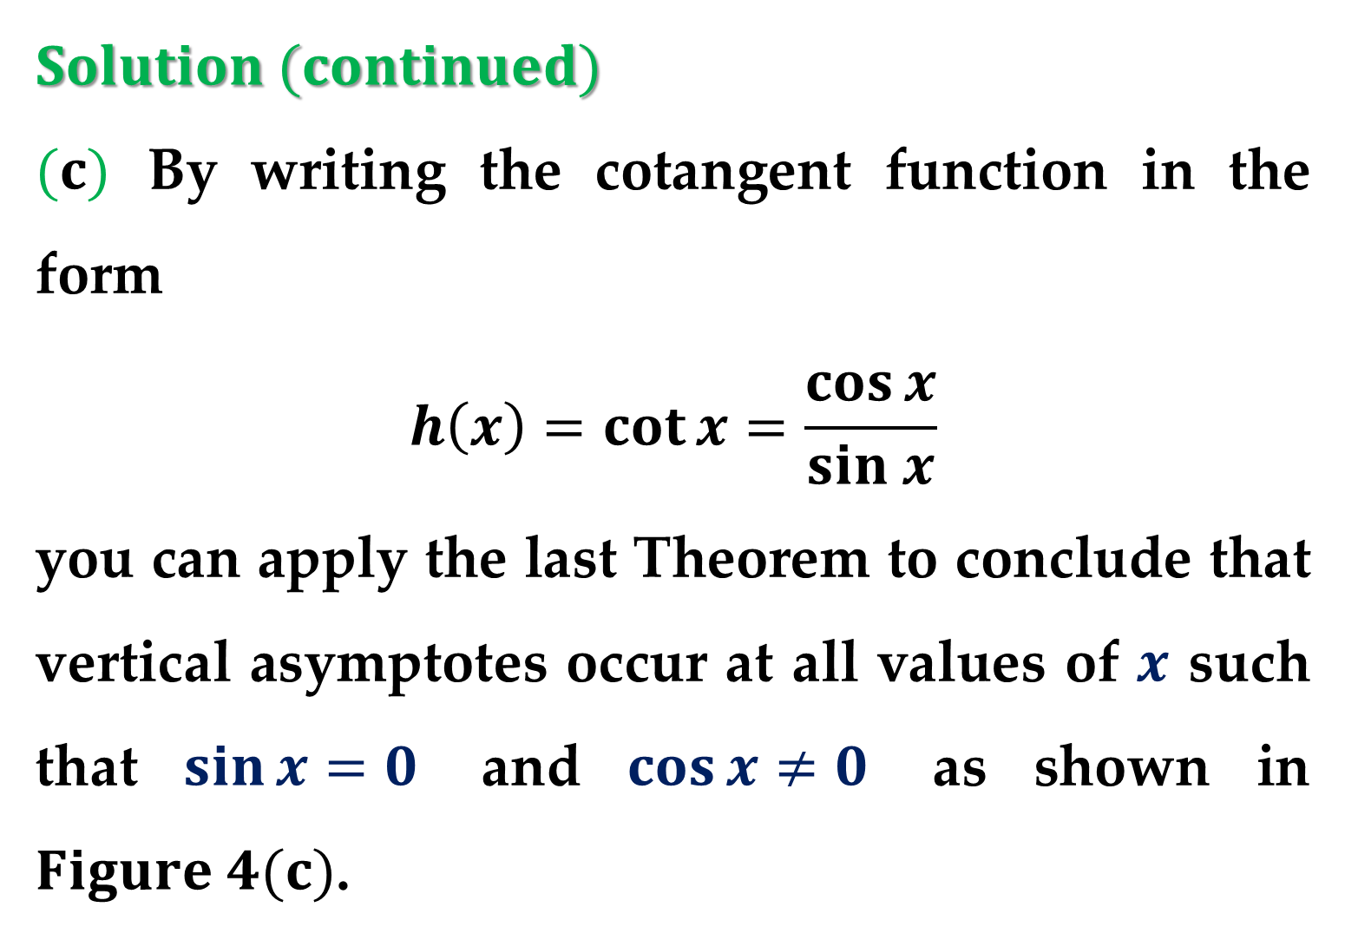
$Solution (continued)$
$(c)$ By writing the cotangent function in the form
$$h\left(x\right)=\cot{x}=\frac{\cos{x}}{sin x}$$
you can apply the last Theorem to conclude that vertical asymptotes occur at all values of $x$ such that $\sin{x}=0$ and $\cos{x}≠0$ as shown in $Figure 4(c)$.

Slide 25
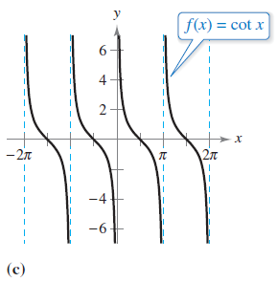
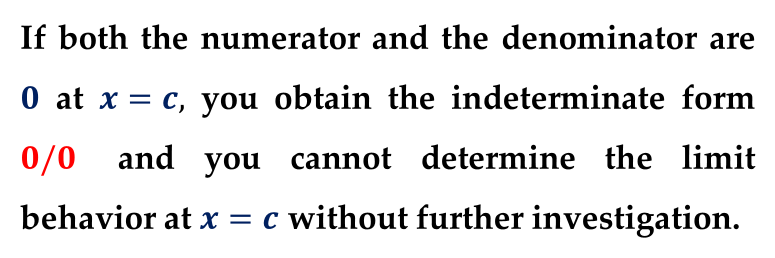
$Solution (continued)$
If both the numerator and the denominator are $0$ at $x=c,$ you obtain the indeterminate form $0/0$ and you cannot determine the limit behavior at $x=c$ without further investigation.

Slide 26
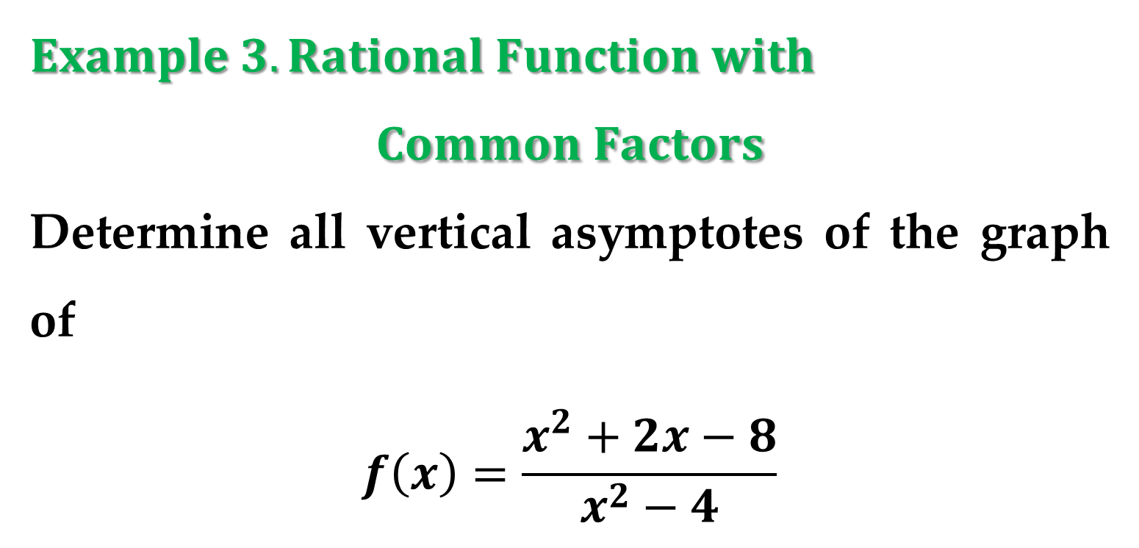
$Example 3. Rational Function with$
$$Common Factors$$
Determine all vertical asymptotes of the graph of
$$f\left(x\right)=\frac{x^{2}+2x−8}{x^{2}−4}$$

Slide 27
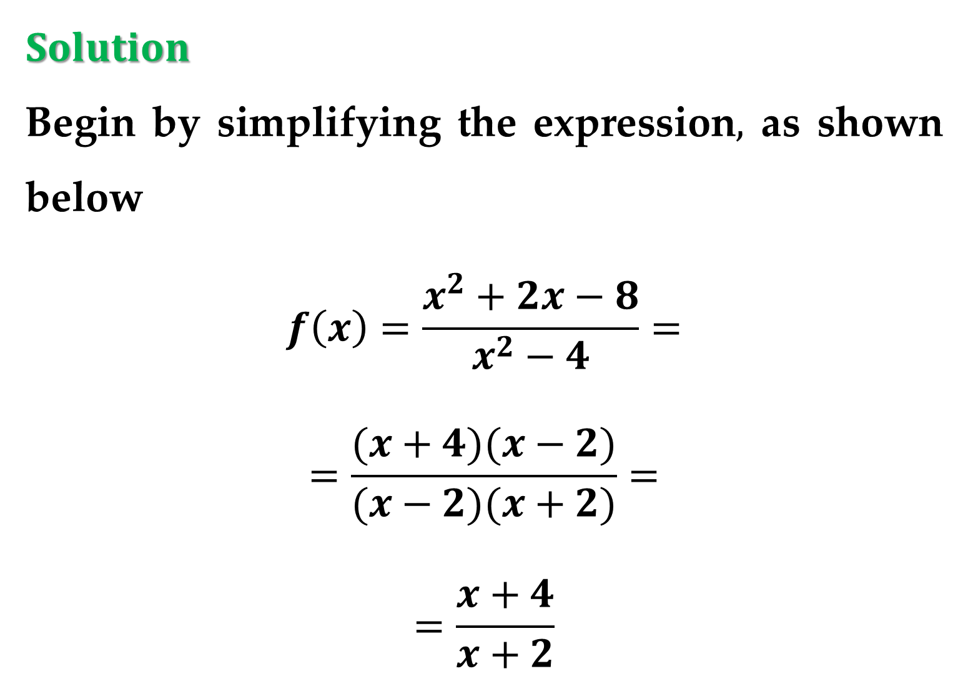
$Solution$
Begin by simplifying the expression$,$ as shown below
$$f\left(x\right)=\frac{x^{2}+2x−8}{x^{2}−4}=$$
$$=\frac{(x+4)(x−2)}{(x−2)(x+2)}=$$
$$=\frac{x+4}{x+2}$$

Slide 28
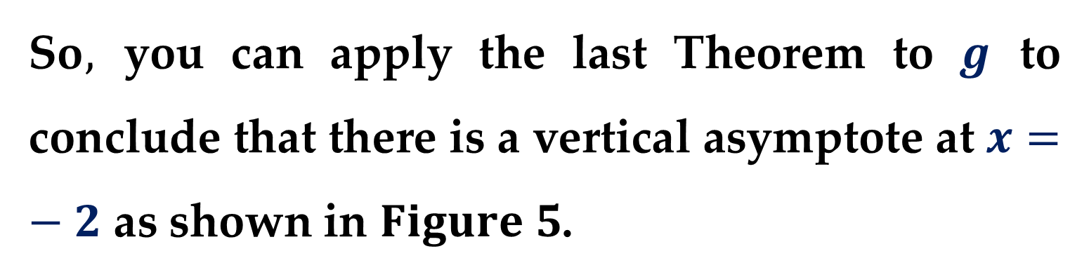
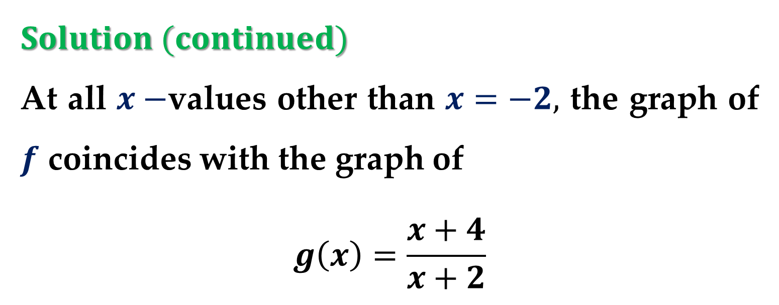
$Solution (continued)$
At all $x−$values other than $x=−2,$ the graph of $f$ coincides with the graph of
$$g\left(x\right)=\frac{x+4}{x+2}$$
So$,$ you can apply the last Theorem to $g$ to conclude that there is a vertical asymptote at $x=−2$ as shown in $Figure 5$.

Slide 29
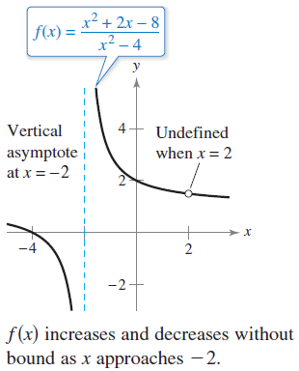
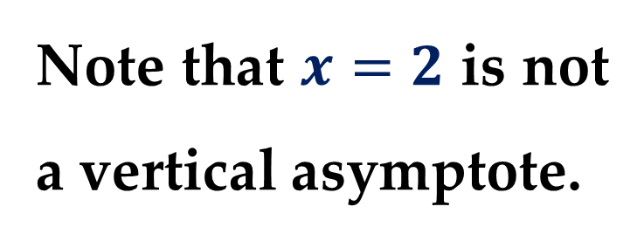
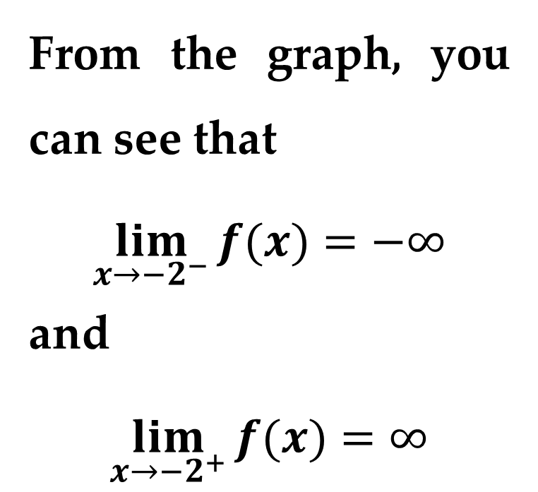
$Solution (continued)$
From the graph, you can see that
$$\lim_{x→−2^{−}}{f(x)}=−∞$$
and
$$\lim_{x→−2^{+}}{f(x)}=∞$$
Note that $x=2$ is not a vertical asymptote.

Slide 30
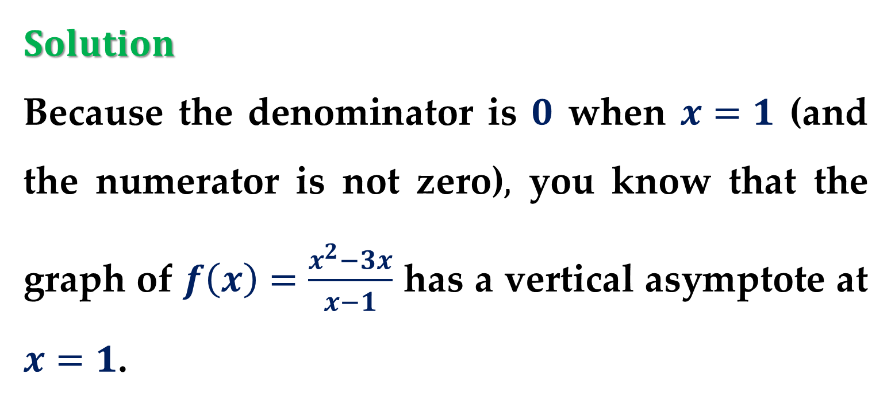
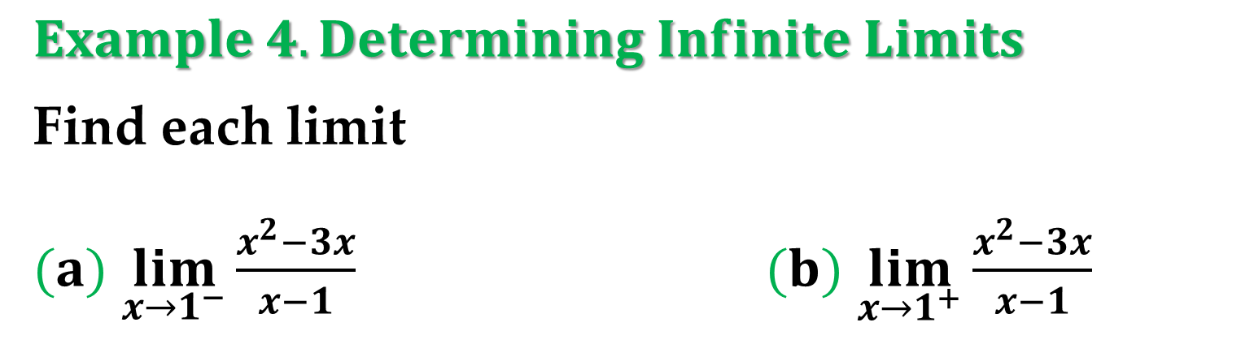
$Example 4. Determining Infinite Limits$
Find each limit
$(a)$ $\lim_{x→1^{−}}{\frac{x^{2}−3x}{x−1}}$ $(b)$ $\lim_{x→1^{+}}{\frac{x^{2}−3x}{x−1}}$
$Solution$
Because the denominator is $0$ when $x=1$ (and the numerator is not zero)$,$ you know that the graph of $f\left(x\right)=\frac{x^{2}−3x}{x−1}$ has a vertical asymptote at $x=1$.

Slide 31
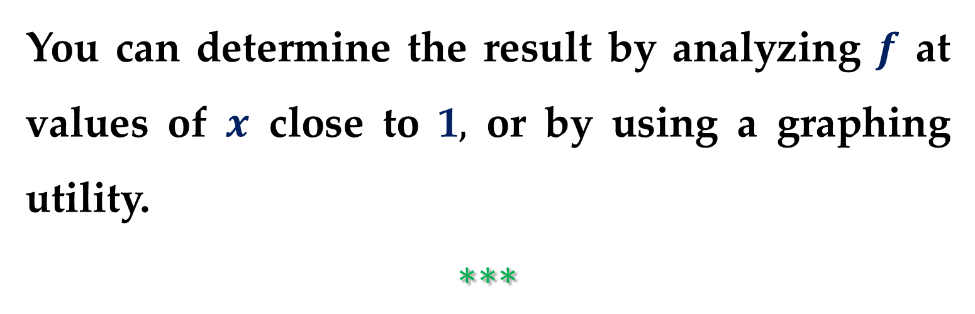
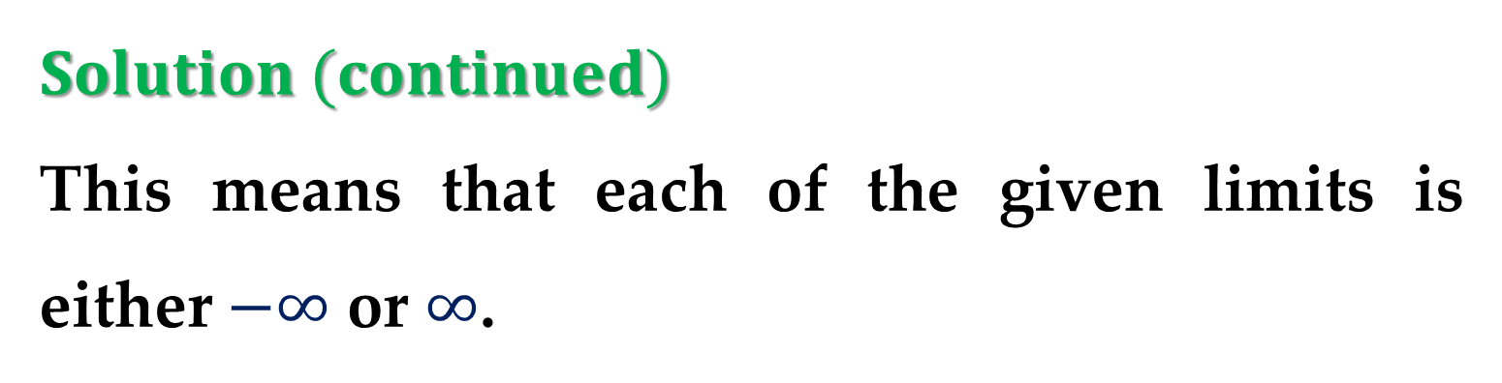
$Solution (continued)$
This means that each of the given limits is either $−∞$ or $∞$.
You can determine the result by analyzing $f$ at values of $x$ close to 1$,$ or by using a graphing utility.
$$∗∗∗$$

Slide 32

$$Theorem. Properties of Infinite Limits$$
Let $c$ and $L$ be real numbers and let $f$ and $g$ be functions such that
$\lim_{x→c}{f(x)}=∞$ and $\lim_{x→c}{g(x)}=L$
1. Sum or Difference: $\lim_{x→c}{[f±g]}=∞$
2. Product: $\lim_{x→c}{[fg]}=∞, L>0$
$\lim_{x→c}{[fg]}=−∞, L<0$
3. Quotient: $\lim_{x→c}{\frac{g(x)}{f(x)}}=0$

Slide 33

$Remark$
Similar properties hold for one-sided limits and for functions for which the limit of $f(x)$ as $x$ approaches $c$ is $−∞$.

Slide 34


$Example 5. Determining Limits$
$(a)$ Because $\lim_{x→0}{1}=1$ and $\lim_{x→0}{\frac{1}{x^{2}}}=∞,$ you can write
$$\lim_{x→0}{(1+\frac{1}{x^{2}})}=∞$$
$(b)$ Because $\lim_{x→1^{−}}{(x^{2}+1)}=2$ and $\lim_{x→1^{−}}{(\cot{πx})}=−∞,$ you can write
$$\lim_{x→1^{−}}{\frac{x^{2}+1}{\cot{πx}}}=0$$

Slide 35

$Example 5. Determining Limits$
$(c)$ Because $\lim_{x→0^{+}}{3}=3$ and $\lim_{x→0^{+}}{\cot{x}}=∞,$ you can write
$$\lim_{x→0^{+}}{3\cot{x}}=∞$$

Slide 36

$$\lim_{x→0}{\frac{\frac{1}{x+1}−1}{x}}=\lim_{x→0}{\frac{−1}{x+1}}=−1$$
$$\lim_{x→0}{\frac{1−\cos{x}}{\sin{x}}}=\lim_{x→0}{\frac{1−\cos{x}}{x}} \frac{1}{\frac{\sin{x}}{x}}=\lim_{x→0}{\frac{0}{1}}=0$$
$$\lim_{t→4}{\frac{4.9t^{2}−78.4}{4−t}}=\lim_{t→4}{\frac{−4.9\left(t+4\right)}{1}}=−39.2$$
$$0=−4.9t^{2}+250 →t=7.143$$

Slide 37
Thank you for attention

